Slide 1
AP2C – Time-Series Dimension Ordering in PyTorch
Ching Chang

Slide 2

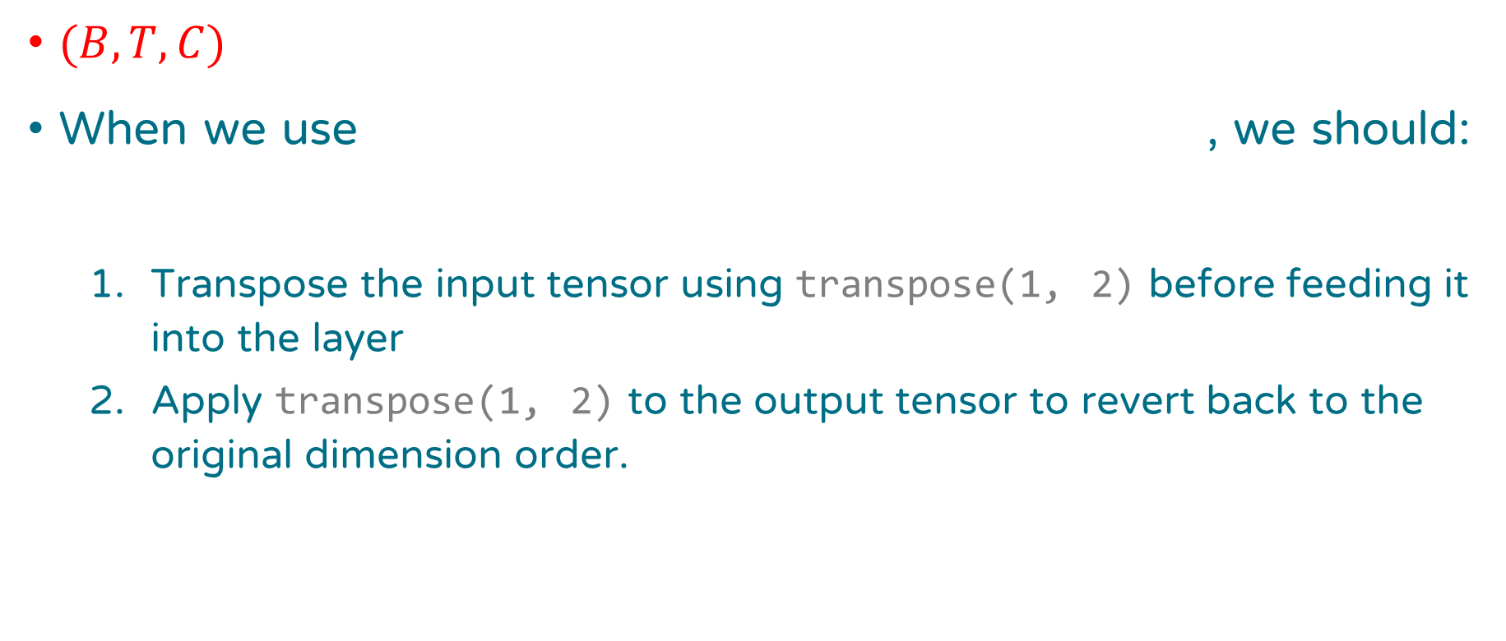
Conclusion
$(B, T, C)$
When we use , we should:
Transpose the input tensor using transpose(1, 2) before feeding it into the layer
Apply transpose(1, 2) to the output tensor to revert back to the original dimension order.
a layer with a name ending in “1d”
nn.GroupNorm
tsai

Slide 3

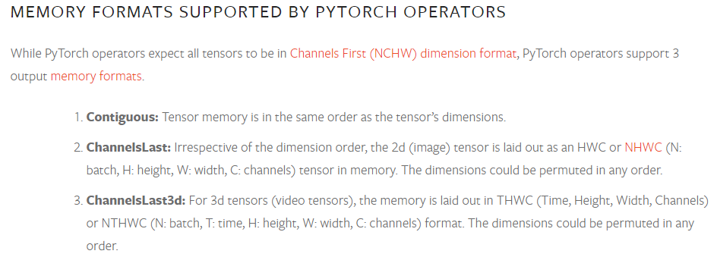
From PyTorch Blog

Slide 4
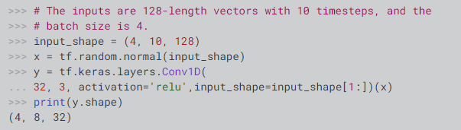
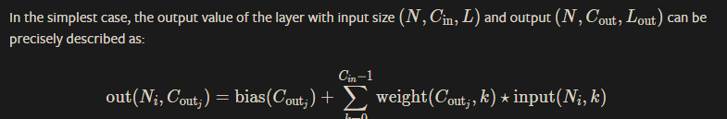
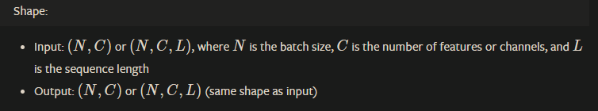
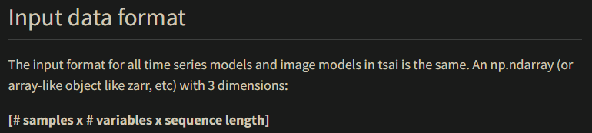
Dimensions of Time-Series in Different Libraries
channel-last (NHWC) vs. channel-first (NCHW)
TensorFlow’s Conv1D:
TensorFlow
(B, T, C)
PyTorch
(B, C, T)
tsai
(B, C, T)
PyTorch’s Conv1d:
PyTorch’s BatchNorm1d:

Slide 5
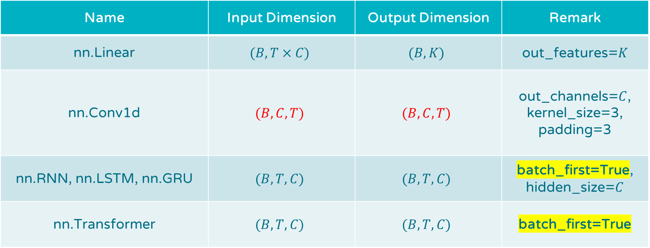
Key PyTorch Layers for Model Building
Name | Input Dimension | Output Dimension | Remark
nn.Linear | $$(B, T×C)$$ | $$(B,K)$$ | out_features=$K$
nn.Conv1d | $$(B, C,T)$$ | $$(B, C, T)$$ | out_channels=$C$, kernel_size=3, padding=3
nn.RNN, nn.LSTM, nn.GRU | $$(B, T, C)$$ | $$(B, T, C)$$ | batch_first=True, hidden_size=$C$
nn.Transformer | $$(B, T, C)$$ | $$(B, T, C)$$ | batch_first=True

Slide 6
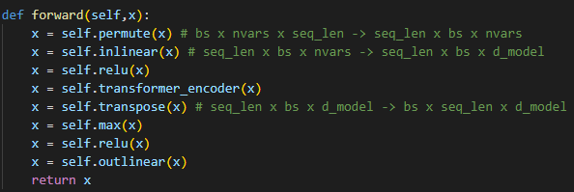
Transformer in tsai
tsai: (B, C, T)
batch_first=False
B C T
T B C

Slide 7
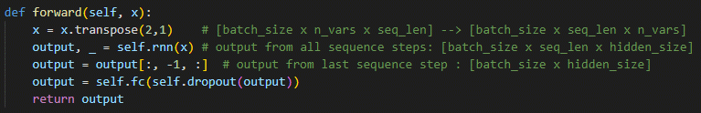
RNN in tsai
tsai: (B, C, T)
batch_first=True
B C T
B T C
B C

Slide 8
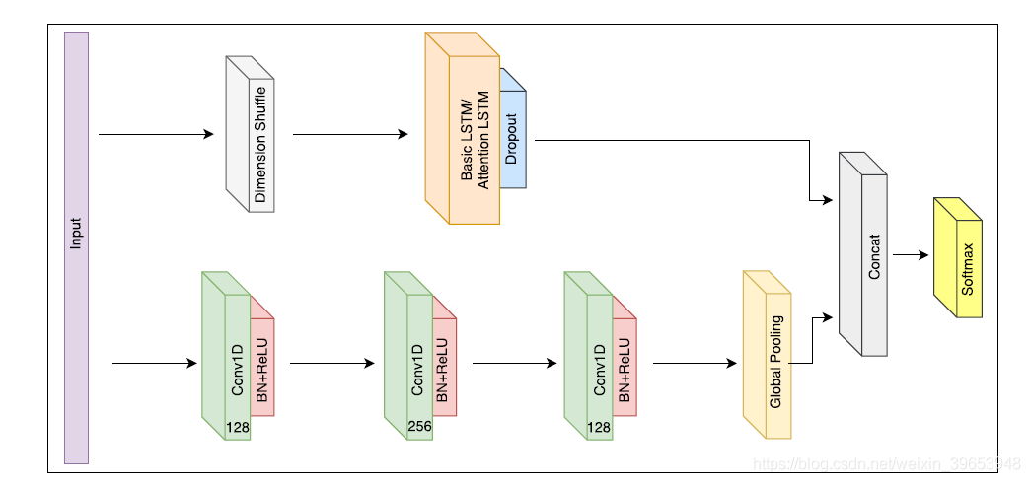
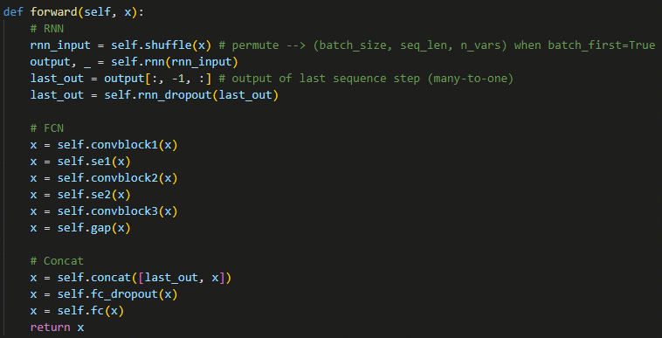

RNN_FCN in tsai (RNN + CNN)
tsai: (B, C, T)
batch_first=True
B T C
(B, C)
(B, C, T)
(B, C, T) → (B, C, 1) → (B, C)

Slide 9
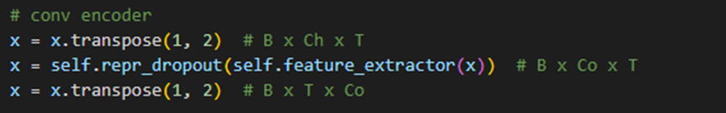
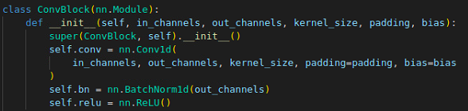
CNN-based in PyTorch
ts2vec: (B, T, C)
(B, T, C) → (B, C, T)
(B, C, T)
(B, C, T) → (B, T, C)
nn.Conv1d
nn.BatchNorm1d
nn.ReLU
element-wise

Slide 10
Every layer with “1d”
Ignoring the “Lazy” version (ex: nn.LazyConv1d)
Convolution Layers
nn.Conv1d, nn.ConvTranspose1d
Pooling Layers
nn.MaxPool1d, nn.MaxUnpool1d
nn.AvgPool1d, nn.AdaptiveAvgPool1d
Padding Layers
nn.ReflectionPad1d, nn.ReplicationPad1d, nn.ConstantPad1d
Normalization Layers
nn.BatchNorm1d
nn.InstanceNorm1d
Dropout Layers
nn.Dropout1d (We always use nn.Dropout)
CNN-related
Please note that nn.LayerNorm and nn.GroupNorm don’t have “1d” at the end.
Q: Why is nn.LayerNorm the only one that can accept both channel-first and channel-last inputs?

Slide 11
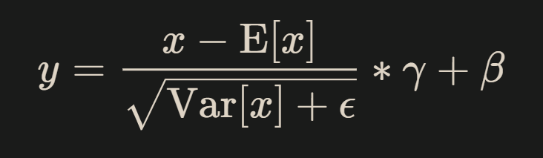
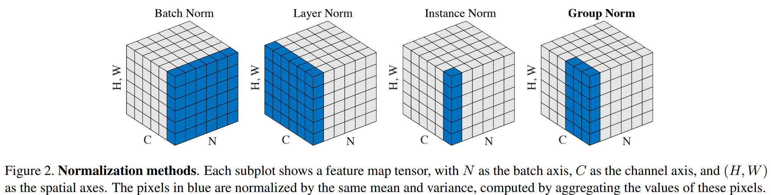
Normalization Layers
Affine
shift → scale → re-scale → re-shift
learnable

Slide 12
Data Flow
Hidden layer
Input layer
1’
2’
3’
1
2
3
1’
2’
3’
1
2
3
1’
2’
3’
1
2
3
1’
2’
3’

Slide 13

Z-Score Normalization (also Zero-Mean Normalization)
$$m_{1}, μ_{1}$$
Hidden layer
Input layer
1’
2’
3’
1
2
3
1’
2’
3’
1
2
3
1’
2’
3’
1
2
3
1’
2’
3’

Slide 14

Z-Score Normalization → Batch Normalization
Batch Normalization = Z-Score Normalization in hidden layers
$${m′}_{1}, {μ′}_{1}$$
$$m_{1}, μ_{1}$$
Hidden layer
Input layer
1’
2’
3’
1
2
3
1’
2’
3’
1
2
3
1’
2’
3’
1
2
3
1’
2’
3’
B
(N, C) → (N, C)
z-score
We apply normalization on each channel/feature
B
(N, C) → (N, C)
BN

Slide 15
Data Normalization → Batch Normalization
We add another dimension, so (B, C) becomes (B, C, T)
$${m′}_{1}, {μ′}_{1}$$
$$m_{1}, μ_{1}$$
Hidden layer
Input layer
1’
2’
3’
1
2
3
1’
2’
3’
1
2
3
1’
2’
3’
1
2
3
1’
2’
3’
(B, C, T) → (B, C, T)
z-score
(B, C, T) → (B, C, T)
BN

Slide 16

Layer Normalization
$${m′}_{1}, {μ′}_{1}$$
$$m_{1}, μ_{1}$$
Hidden layer
Input layer
1’
2’
3’
1
2
3
1’
2’
3’
1
2
3
1’
2’
3’
1
2
3
1’
2’
3’
(B, C, T) → (B, C, T)
LN

Slide 17
Instance Normalization
$${m′}_{1}, {μ′}_{1}$$
$$m_{1}, μ_{1}$$
Hidden layer
Input layer
1’
2’
3’
1
2
3
1’
2’
3’
1
2
3
1’
2’
3’
1
2
3
1’
2’
3’
(B, C, T) → (B, C, T)
IN

Slide 18
Group Normalization
$${m′}_{1}, {μ′}_{1}$$
$$m_{1}, μ_{1}$$
Hidden layer
Input layer
1’
2’
3’
1
2
3
1’
2’
3’
1
2
3
1’
2’
3’
1
2
3
1’
2’
3’
(B, C, T) → (B, C, T)
GN

Slide 19




Normalization Layers
With Transformers, (B, T, C) format works without concern for dimension ordering, as Layer Normalization is the default normalization layer.
The only one that can accept both channel-first and channel-last inputs.
(Because it doesn’t care where the channel is.)
nn.BatchNorm1d
nn.LayerNorm
nn.InstanceNorm1d
nn.GroupNorm
(B, C, T) → (B, C, T)
BN
(B, C, T) → (B, C, T)
LN
(B, C, T) → (B, C, T)
IN
(B, C, T) → (B, C, T)
GN

Slide 20
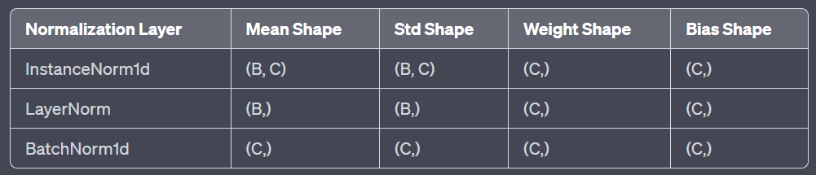
Normalization Layers
Affine is learnable reverse z-score normalization with the purpose of learning the best transformation for the specific task.
(Affine is applied to the channel dimension, regardless of the chosen normalization layer.)
Affine
(B, C, T) → (B, C, T)
BN
(B, C, T) → (B, C, T)
LN
(B, C, T) → (B, C, T)
IN
(B, C, T) → (B, C, T)
GN

Slide 21
Thank you

